Slide 1

Smart cities – Technology, management and governance
Substitution of tram line 179 with smart bikeway

Slide 2
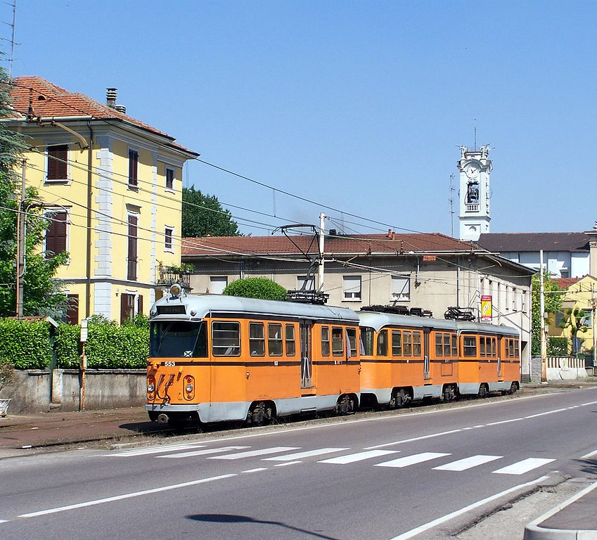
TRAM LINE179
The tram line 179 Milano-Limbiate was opened in 1882 and from 1939 is managed by ATM(azienda trasporti milanese).
Recently it was plagued by security and maintenance issues and it has been facing constant interruptions and ride reductions.

Slide 3
MAIN GOAL
Creating a way for bicycles and pedestrians to substitute the tram line 179 which covers SP44 and links Limbiate(MB), Paderno Dugnano(MI) and other town halls in the north of Milan with the first stop of the yellow underground Comasina M3. Our idea arises from the structure and strategical position of this street: straight and passing through many town halls.
Nowadays the line only works during the peak times and its target is composed by people aged between 14 and 65 and therefore able to use means of trasport like bikes and scooters.

Slide 4
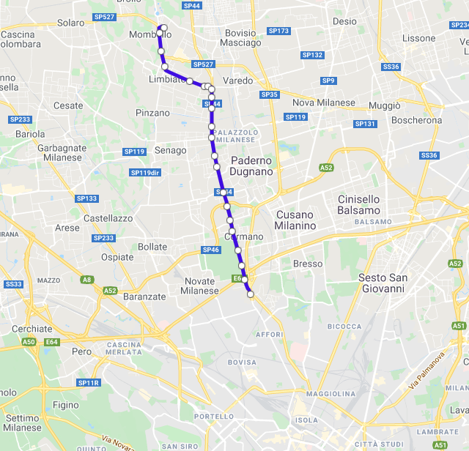
TRAM LINE179
Departure: Limbiate (MB)
Arrival: Comasina M3 (MI)
Municipalities crossed: Varedo (MB) –Senago (MI)- Paderno Dugnano (MI) – Cormano (MI)
Line length: 10,1km
Travel time: 45’approximately

Slide 5
Use of the tram¹
MORNING
AFTERNOON
To Milan |  | To Limbiate
Town hall | Passengers | Town hall | Passengers
Limbiate | 697 | Limbiate | 135
Varedo | 95 | Varedo | 43
Senago | 145 | Senago | 39
Paderno | 635 | Paderno | 142
Cormano | 259 | Cormano | 96
Milano | 15 | Milano | 363
To Milan |  | To Limbiate
Town hall | Passengers | Town hall | Passengers
Limbiate | 448 | Limbiate | 117
Varedo | 65 | Varedo | 36
Senago | 70 | Senago | 12
Paderno | 233 | Paderno | 107
Cormano | 114 | Cormano | 101
Milano | 4 | Milano | 1409
¹ https://www.amicitram.eu

Slide 6
Mobility solution
Our solution aims to extend solutions already implemented in Milan by some companies like Lime, Mobike, Helbiz Italia which provide bicycles and scooters around the city (more than 10 000 rents per day). All these companies use free-flowing sharing (without fixed rent stations) which allows the right distribution of the means of transport according to user needs.

Slide 7
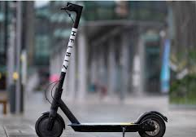
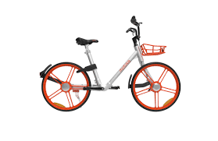
Means of transport
Nowadays, the main vehicles used are bicycles and scooters. For the bikes the solution can be traditional or electric and for the scooters only the electric version. A traditional bike can reach 12-15 km/h while both the electric vehicles top at around 22-25km/h.

Slide 8
Advantages
Travel time
Congestion reduction
Economic saving
Sustainability
Physical activity

Slide 9
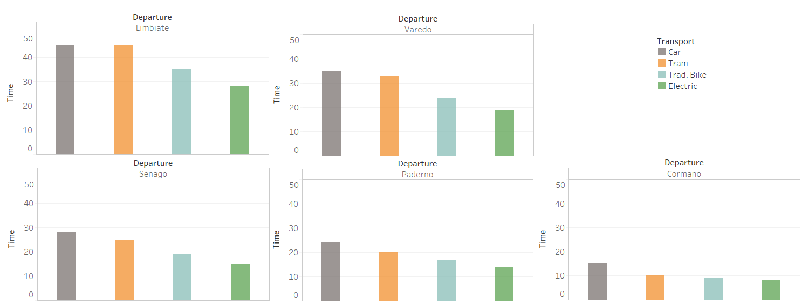
Travel time
During peak times as the morning and late afternoon, on the SP44 there is heavy traffic. Below we compare different travel times to reach the underground station of Comasina M3 calculated in said hours:

Slide 10
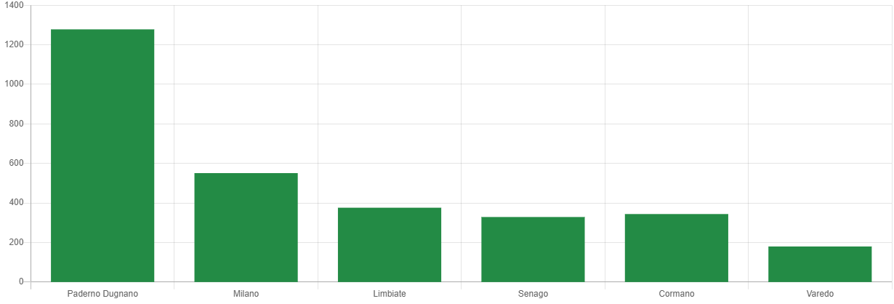
Congestion reduction
Below, the daily average number of vehicles that transit through SP44 divided by departure’s town hall (average calculated over 1 week):
Trips
https://od.tomtom.com/

Slide 11
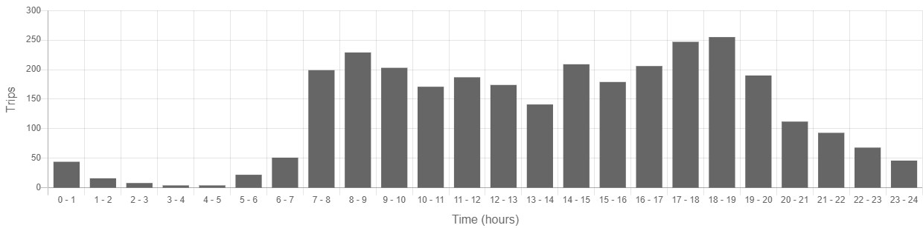
Congestion reduction
Below, the daily average number of vehicles that transit through SP44 divided by time slot(average calculated over 1 week):
https://od.tomtom.com/

Slide 12
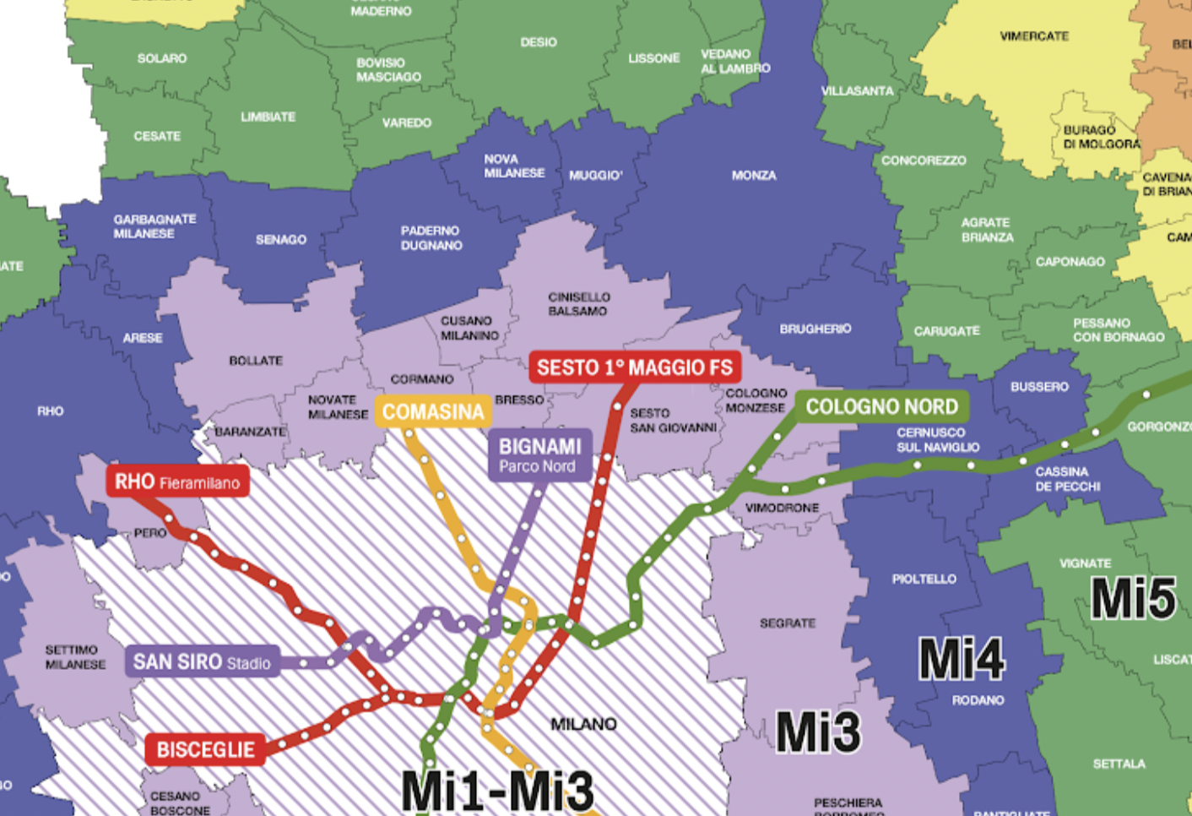
Economic saving
Thanks to sustainable mobility, the cost per user will gradually decrease as you move away from the center of Milan.
Below the subdivision by zones of the hinterland of Milan¹:
¹ https://www.atm.it/

Slide 13
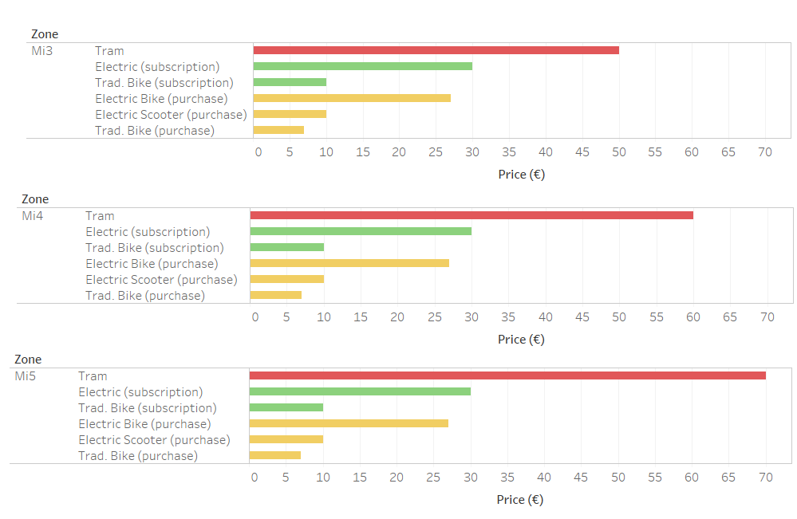
Economic saving

Slide 14
Economic saving
Below the monthly subscription and purchase costs:
Monthly subscription for electric means¹ (scooter or bike) : 30€
Monthly subscription for traditional means² : 10€
Purchase of scooter: 400€ (11€/month)³
Purchase of electric bike: 1000€ (27€/ month)³
Purchase of traditional bike: 250€ (7€/ month)³
¹ https://helbiz.com/
² https://mobike.com/global/
³ monthly cost calculated for a life-cycle of 3 years

Slide 15
Challenges
Climate conditions
Management of elderly users and disabled users

Slide 16
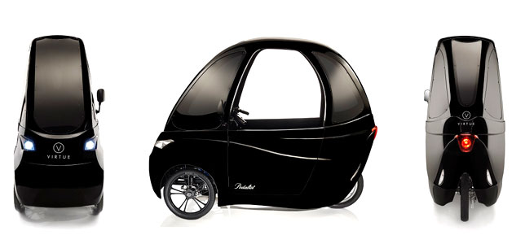
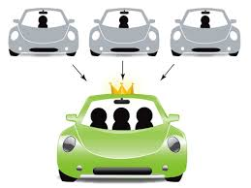

Possible solutions

Slide 17
Investimenti pubblici per sostenibilità
Bikeway costs average around 50 000€ and 150 000€ per km based on the implemented safety measures, asphalt type and implementation. Therefore, the total cost of this projects will oscillate between 500 000€ and 1 500 000€¹.
With regards to investments, european initiative Life ², translated into different projects by business corporations offers contributions to sustainable projects. For example, Assolombarda ³ offered in 2020 450 million euros to promote environmental friendly projects with a non-repayable funding of up to 60% with limits of 3M€ and 36 months to completion.
¹ http://www.fiab-onlus.it/downl2/prezpist.pdf
² https://ec.europa.eu/easme/en/life
³ https://www.assolombarda.it/

Slide 18
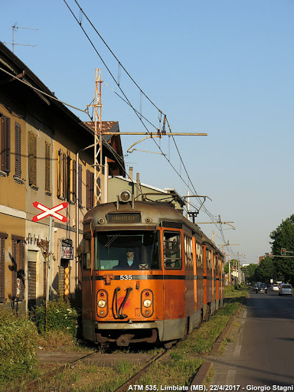
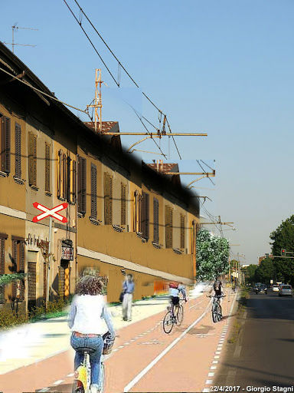
Before and after…

